Slide 1
Lecture 12

Slide 2
Default Processing in XSLT
The default processing in XSLT is to process the XPath root node
The default processing for various node types is
  Root node: Apply templates to children
  Element nodes: Apply templates to children
  Text nodes: Copy text to the result tree
  Comment nodes: Do nothing
  PI nodes: Do nothing
  Attribute nodes: Copy the value of the attribute to the result tree
  Namespace nodes: Do nothing

Slide 3
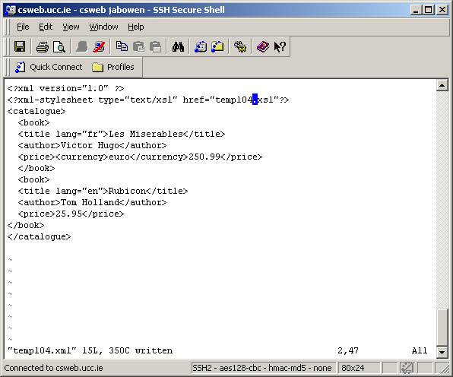
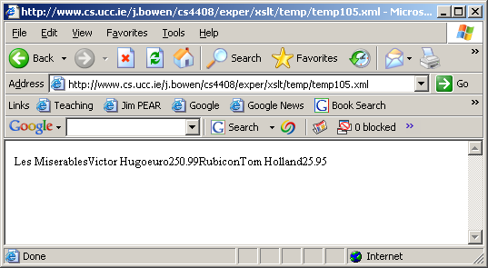
Default processing example
The following is the simplest possible XSLT stylesheet
<?xml version="1.0"?>
<xsl:transform version="1.0" xmlns:xsl="http://www.w3.org/1999/XSL/Transform">
</xsl:transform
It contains no templates so default processing is used
  the string-value of the text nodes is output
  remember:attribute nodes are not regarded as children of an element node
  that's why the values of the attributes is not printed above

Slide 4
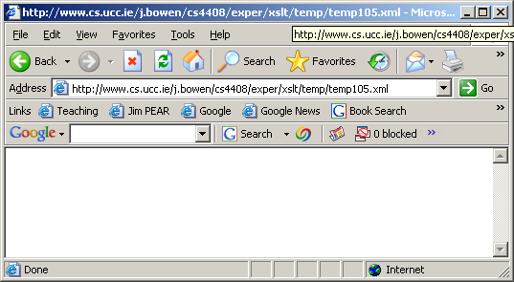
Overriding default processing (contd.)
<?xml version="1.0"?>
<xsl:transform version="1.0" xmlns:xsl="http://www.w3.org/1999/XSL/Transform">
<xsl:template match="/">
</xsl:template>
</xsl:transform>
Default processing is overridden
  the template for the root node specifies that nothing should be output
  its children nodes are not processed

Slide 5
XPath axes (contd.)
At the end of the last lecture, we looked as the child axis
We will now look at the full set of axes

Slide 6
Axis Specifiers
A XPath node has thirteen axes:
  ancestor
    Ancestors of the current node
  ancestor-or-self
    Ancestors, including the current node
  attribute
    Attributes of the current node (abbreviated "@")
  child
    Children of the current node (the default axis)
      (never contains namespace nodes)
  descendant
    Descendants of the current node
      (thus, never contains attribute or namespace nodes)
  descendant-or-self
    Descendants, including the current node (abbreviated "//")

Slide 7
Axis Specifiers (contd.)
  following / following-sibling
    Nodes which occur after the current node, in document order
  preceding / preceding-sibling
    Nodes which occur before the current node, in document order (returned in reverse-document order)
  namespace
    The namespace nodes of the current node. An element has a namespace node
      for every attribute on the element whose name starts with xmlns: ;
      for every attribute on an ancestor element whose name starts xmlns: unless the element itself or a nearer ancestor redeclares the prefix;
      for an xmlns attribute, if the element or some ancestor has an xmlns attribute, and the value of the xmlns attribute for the nearest such element is non-empty
  parent
    The parent of the current node (abbreviated "..")
  self
    The current node (abbreviated ".")

Slide 8
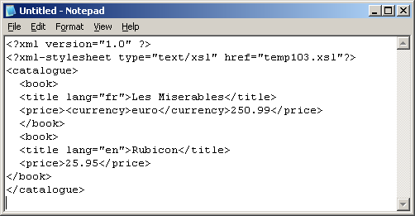
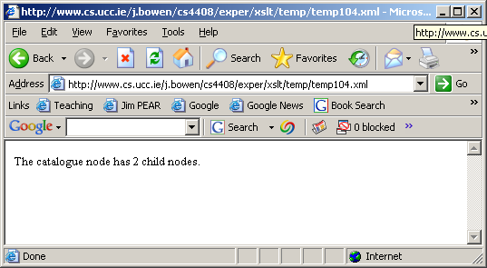
A reminder: the child axis
<?xml version="1.0"?>
<xsl:transform version="1.0" xmlns:xsl="http://www.w3.org/1999/XSL/Transform">
<xsl:template match="/">
<body> The catalogue node has
<xsl:value-of select="count(./catalogue/child::*)"/>
child nodes. </body>
</xsl:template>
</xsl:transform>

Slide 9
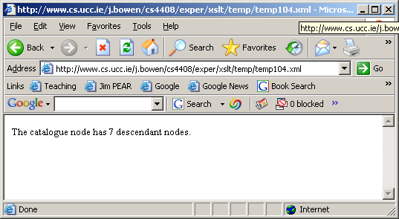
the descendant axis
<?xml version="1.0"?>
<xsl:transform version="1.0" xmlns:xsl="http://www.w3.org/1999/XSL/Transform">
<xsl:template match="/">
<body>The catalogue node has
<xsl:value-of select="count(./catalogue/descendant::*)"/>
descendant nodes. </body>
</xsl:template>
</xsl:transform>
Note that only element descendant nodes are counted
This is because the node test * matches only nodes of the current principal type -- which is element nodes in this case

Slide 10

A different node test
<?xml version="1.0"?>
<xsl:transform version="1.0" xmlns:xsl="http://www.w3.org/1999/XSL/Transform">
<xsl:template match="/">
<body>The catalogue node has
<xsl:value-of select="count(./catalogue/descendant::node( ))"/>
descendant nodes. </body>
</xsl:template>
</xsl:transform>
Text nodes are now being counted
The node test node() is true for any sort of node
The attribute nodes are still not counted because they are not regarded as children or descendants

Slide 11
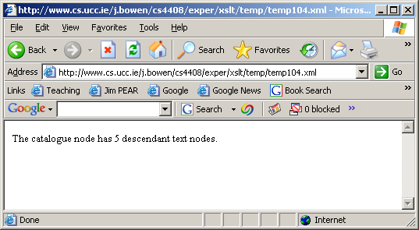
Yet another node test
<?xml version="1.0"?>
<xsl:transform version="1.0" xmlns:xsl="http://www.w3.org/1999/XSL/Transform">
<xsl:template match="/">
<body>The catalogue node has
<xsl:value-of select="count(./catalogue/descendant::text( ))"/>
descendant text nodes. </body>
</xsl:template>
</xsl:transform>
The node test text() is true only for text nodes

Slide 12
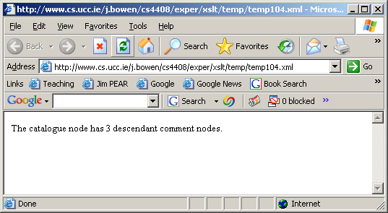
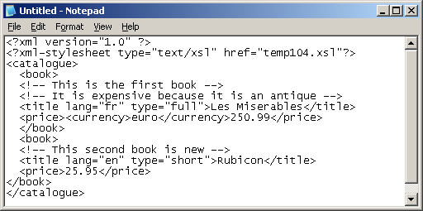
A different XML document: testing for comment nodes
<?xml version="1.0"?>
<xsl:transform version="1.0" xmlns:xsl="http://www.w3.org/1999/XSL/Transform">
<xsl:template match="/">
<body>The catalogue node has
<xsl:value-of select="count(./catalogue/descendant::comment( ))"/>
descendant comment nodes. </body>
</xsl:template>
</xsl:transform>
The node test comment() is true only for text nodes

Slide 13
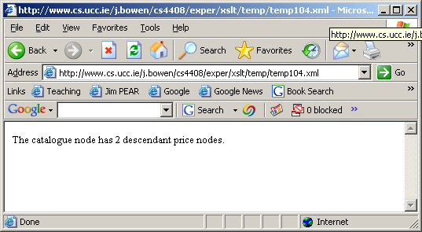
Using tag-names as node tests
<?xml version="1.0"?>
<xsl:transform version="1.0" xmlns:xsl="http://www.w3.org/1999/XSL/Transform">
<xsl:template match="/">
<body>The catalogue node has
<xsl:value-of select="count(./catalogue/descendant::price)"/>
descendant text nodes. </body>
</xsl:template>
</xsl:transform>
The node test price is true only for nodes corresponding to price elements

Slide 14
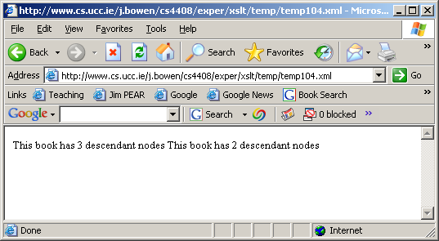
To prepare for other axes: a slightly different usage
<?xml version="1.0"?>
<xsl:transform version="1.0" xmlns:xsl="http://www.w3.org/1999/XSL/Transform">
<xsl:template match="/">
<body> <xsl:apply-templates select="./catalogue/book"/></body>
</xsl:template>
<xsl:template match="book">
This book has <xsl:value-of select="count(./descendant::*)"/> descendant nodes
</xsl:template>
</xsl:transform>

Slide 15
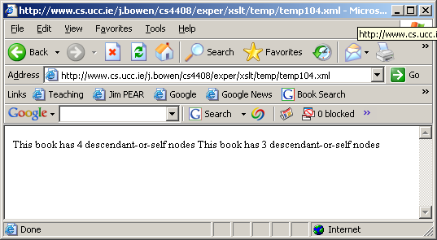
the descendant-or-self axis
<?xml version="1.0"?>
<xsl:transform version="1.0" xmlns:xsl="http://www.w3.org/1999/XSL/Transform">
<xsl:template match="/">
<body> <xsl:apply-templates select="./catalogue/book"/></body>
</xsl:template>
<xsl:template match="book">
This book has <xsl:value-of select="count(./descendant-or-self::*)"/> descendant-or-self nodes
</xsl:template>
</xsl:transform>
As expected, the node counts this time exceed, by 1, those reported on previous slide

